Slide 1





Presentation 2023
MARKETING INSIGHTS FOR CODEX

Slide 2

Content
01
Overview
02
Aim
03
Problem and Insights
04
Conclusion

Slide 3


CodeX
Overview
CodeX is a German beverage company that is aiming to make its mark in the Indian market. A few months ago, they launched their energy drink in 10 cities in India.
Their Marketing team is responsible for increasing brand awareness, market share, and product development. They conducted a survey in those 10 cities and received results from 10k respondents.

Slide 4





Aims
Increase Goodwill
Product Development
CodeX
Brand Awareness

Slide 5

DEMOGRAPHIC INSIGHTS
1. Who prefers energy drink more? (male/female/non-binary?)
2. Which age group prefers energy drinks more?
3. Which type of marketing reaches the most Youth (15-30)?

Slide 6


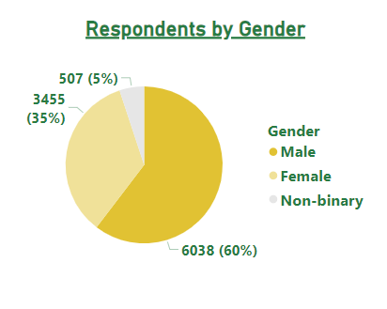
Who prefers energy drink more?

Slide 7
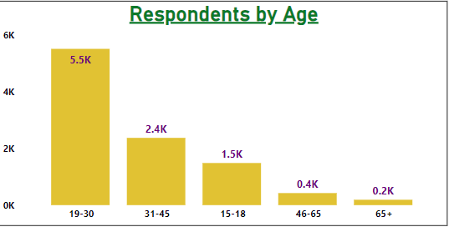
Which age group prefers energy drink﻿s more?

Slide 8
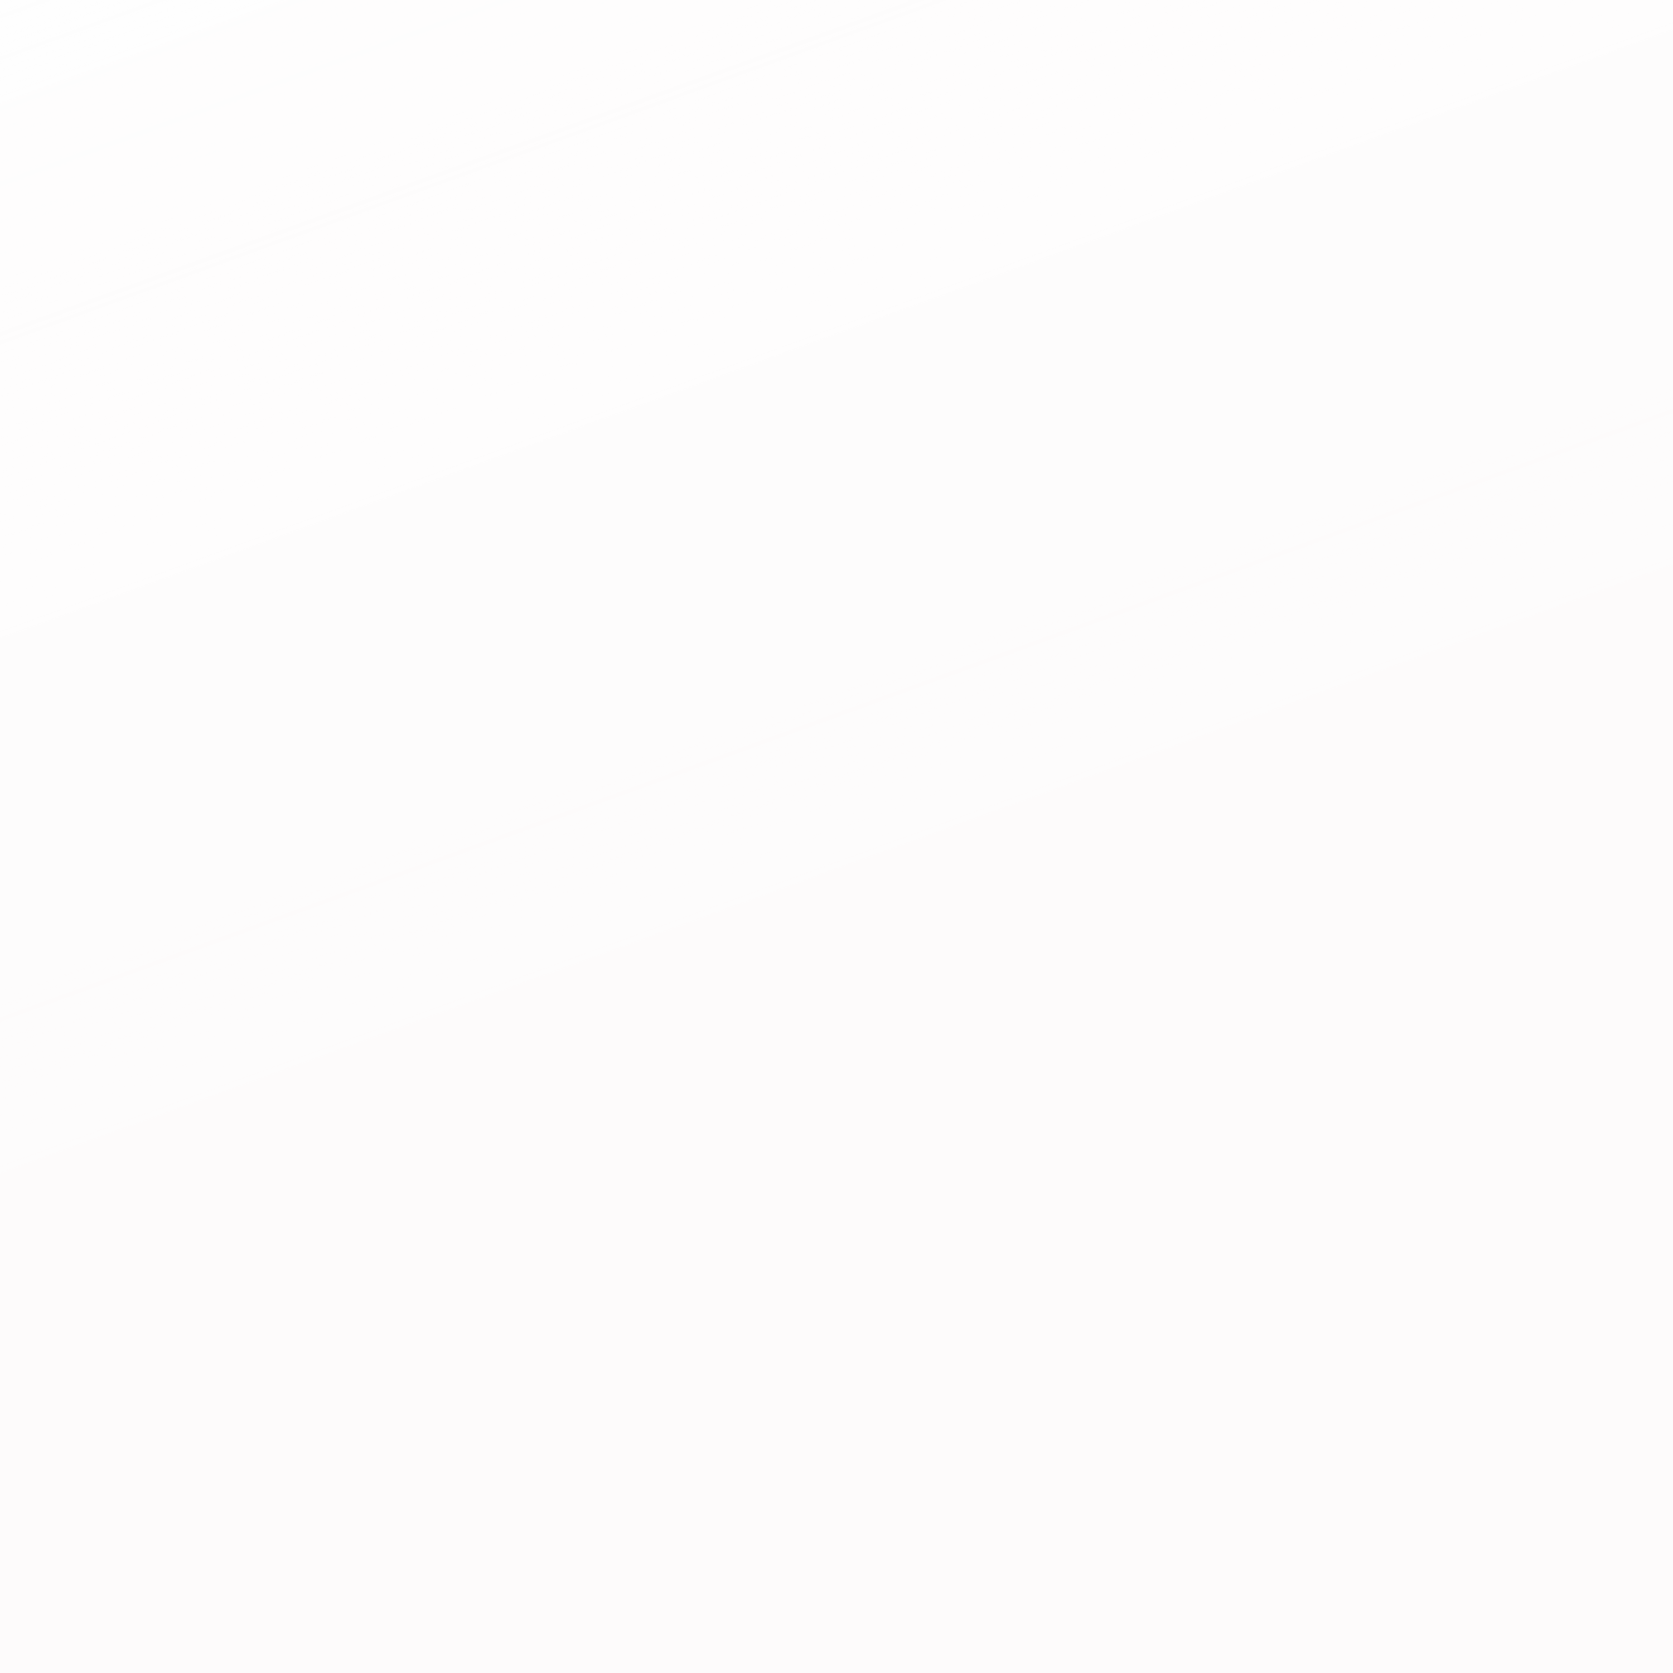

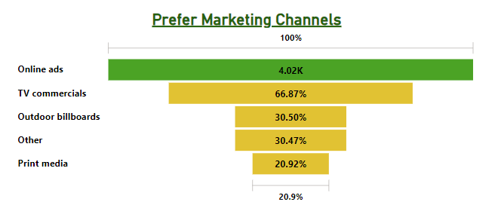
Which type of marketing reaches the most Youth (15-30)?

Slide 9
CONSUMER PREFERENCE
1. What are the preferred ingredients of energy drinks among respondents?
2. What packaging preferences do respondents have for energy drinks?

Slide 10
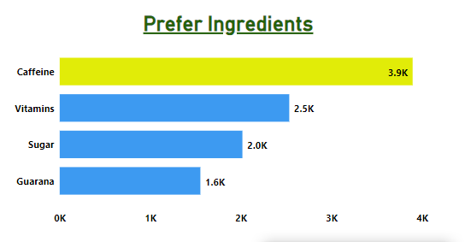

What are the preferred ingredients of energy drinks
among respondents?
Code

Slide 11

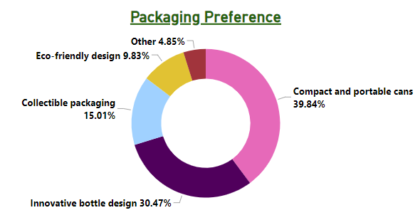
What packaging preferences do respondents have
for energy drinks?
Code

Slide 12
COMPETITION ANALYSIS
1. Who are the current market leaders?
2. What are the primary reasons consumers prefer those
brands over ours?

Slide 13

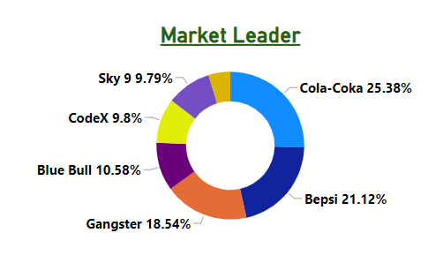

Who are the current market leaders?
The Current market leader is Cola -Coka followed by Bepsi. Code X is choosed by 980 respondents over 10000.

Slide 14
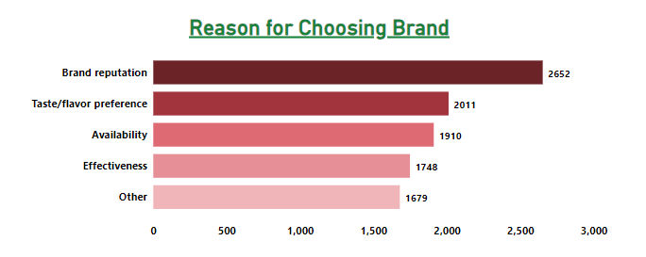
What are the primary reasons consumers prefer
those brands over ours?

Slide 15
MARKETING CHANNELS AND BRAND AWARENESS
1. Which marketing channel can be used to reach more
customers?
2. How effective are different marketing strategies and channels in reaching our customers?

Slide 16
Which marketing channel can be used to reach more customers?

Slide 17
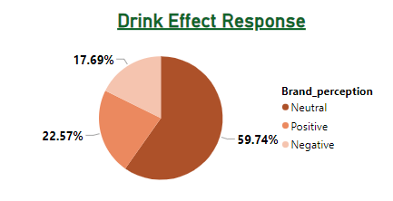
How effective are different marketing strategies and channels in reaching our customers?

Slide 18
BRAND PENETRATION
What do people think about our brand? (overall rating)
2. Which cities do we need to focus more on?

Slide 19
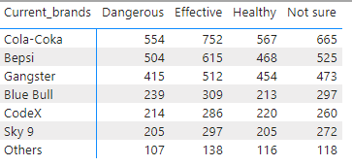
What do people think about our brand? (overall rating)

Slide 20
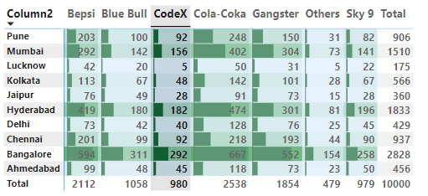
Which cities do we need to focus more on?

Slide 21
PURCHASE BEHAVIOR
1. Where do respondents prefer to purchase energy drinks?
2. What are the typical consumption situations for energy drinks among respondents?
3. What factors influence respondents' purchase decisions, such as price range and limited edition packaging?

Slide 22
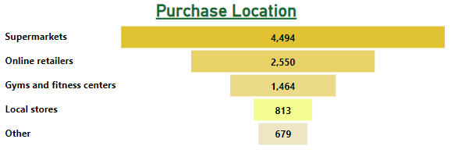
Where do respondents prefer to purchase energy drinks?

Slide 23
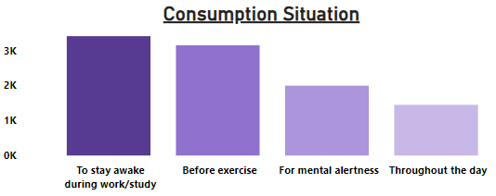
What are the typical consumption situations for energy drinks among respondents?

Slide 24
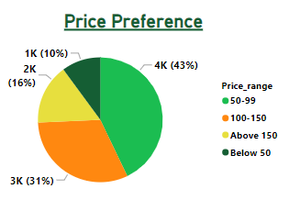
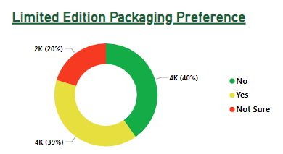
What factors influence respondents' purchase decisions, such as price range and limited edition packaging?

Slide 25
PRODUCT DEVELOPMENT
Which area of business should we focus more on our product development? (Branding/taste/availability)

Slide 26
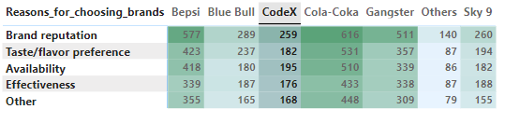
Which area of business should we focus more on our product development? (Branding/taste/availability)
Out of 980 respondents of CodeX, only 259 have choose because of goodwill, 182 for taste and so on.

Slide 27
SECONDARY INSIGHTS

Slide 28
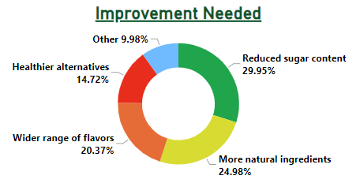
What immediate improvements can we bring to the product?

Slide 29
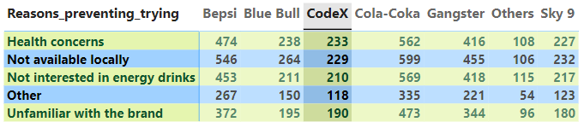
What are the reasons for preventing our brand?
The primary reason to prevent our brand is Health concern , this is because of lack of recognition in market. So we need to focus on brand reputation.

Slide 30

What kind of marketing campaigns, offers, and
discounts we can run?
Social Media is the platform where most of the youths stay updated so increase the brand reputation or product development we need to rum some market compaigns on social media, some giveaways and competitions.
To increase the sale we need to run some offers like BUY 3 GET 1 FREE !!! , Also we can give great discounts on multiple festivals. We can set up some lottery type service to come up with gifts . We can also come up with some social media Collaboration, as we see most of youths are on Instagram so we can do some collaboration with influencers on Instagram.

Slide 31


THANK YOU
SHILPA SAINI
sainishilpa688@gmail.com
https://www.linkedin.com/in/shilpa-saini-a2b6691a0/

